Slide 1
E-OSA Vendor User Guide
Version 4
Vicky Shi
Partner Lifecycle l SCM

Slide 2
Contents
What is E-OSA / Benefits
OSA Process Flow
Activate OSA Account
Submit CAP Design
Submit CAP Implementation Evidence
If CAP be Reject by Jabil

Slide 3
What is E-OSA / Benefits
What is E-OSA
E-OSA is a Jabil electronic vendor on-site assessment system.
Benefits of E-OSA
By using the E-OSA system, we can:
Standardized the vendor on-site assessment process.
Automatically trigger the finding and calculate the assessment result.
Simplified the interaction between Jabil and vendor.
Automatically remind the PIC to complete the required actions in.
Easy to track the activities completed in the OSA process.
Easy to retrieve the OSA records.

Slide 4
OSA Process Flow
Assessment Execution
Create Case in E-OSA
Approver Review Finding
Implement the CAP
Review the CAP Design
Vendor Design CAP
Review the Evidence
Approver Approve CAP
Complete OSA Case
PIC:
Assessor
Approver
Vendor POC

Slide 5
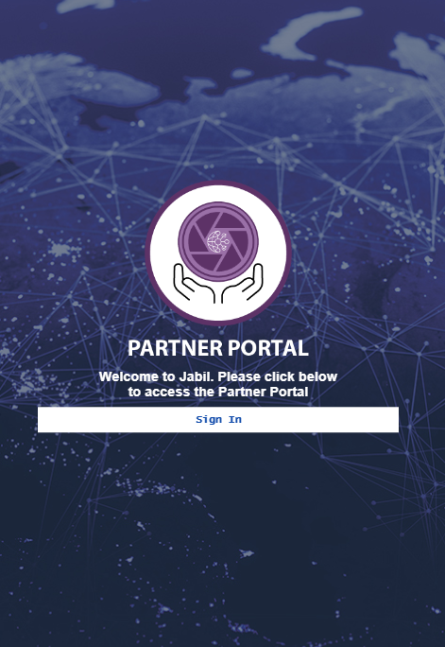
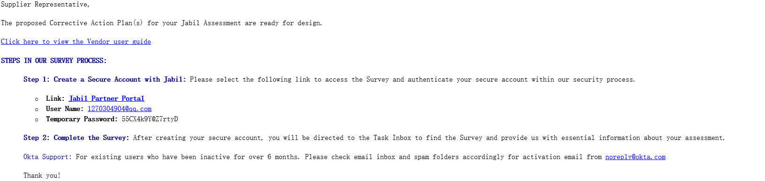
Activate Partner Portal Account
Step 1: Activate Partner Portal account
Vendor will receive a notification from Jabil. Vendor can open the case by either of below ways:
Click the Link “Jabil Partner Portal”
Copy and paste the https link to browser.
Step2: Click the ”Sign in” icon

Slide 6
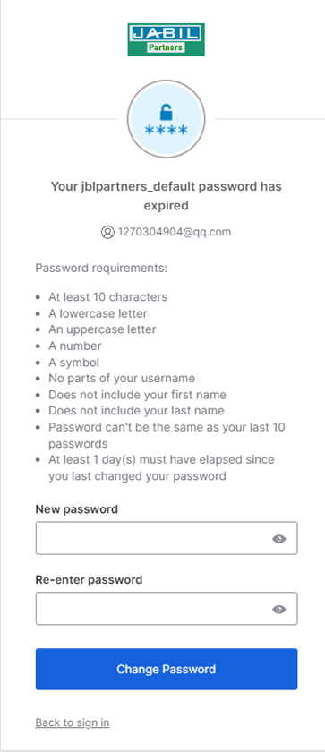
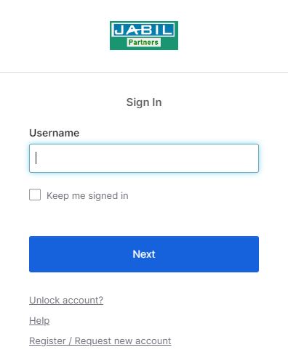
Activate OSA Account & Reset Password
Step 3: Type Username and click “Next” button &Type the temporary password from the mail and click “Verify”.
Step 4: Reset your password according to the request and click “Change Password”.

Slide 7
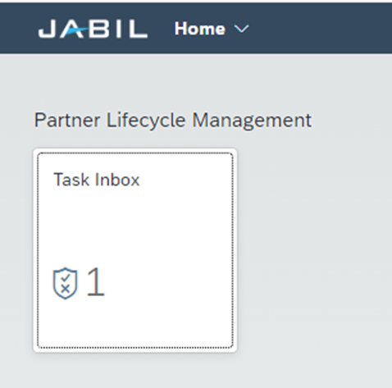
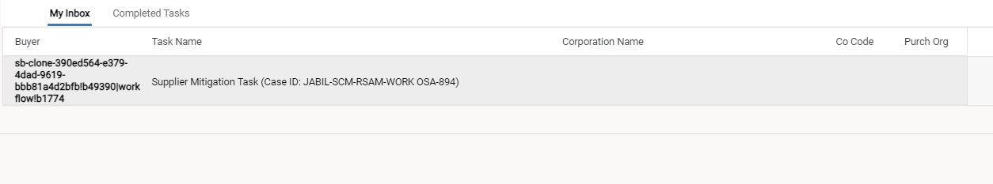
Submit CAP Design
Step 1: Click “Task inbox”. This page will display the number of all pending cases.
Step 2: Click” My inbox” and chose the case that need be dealt with.
Two tabs for reviewing the OSA cases:
My inbox: The cases need to be completed.
Completed Tasks: All the cases that users have submitted will show on this page.

Slide 8
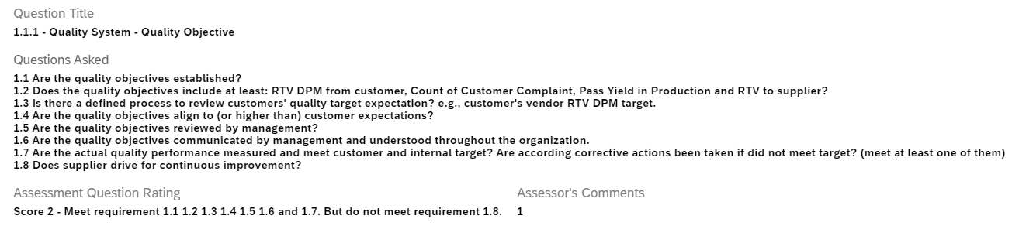
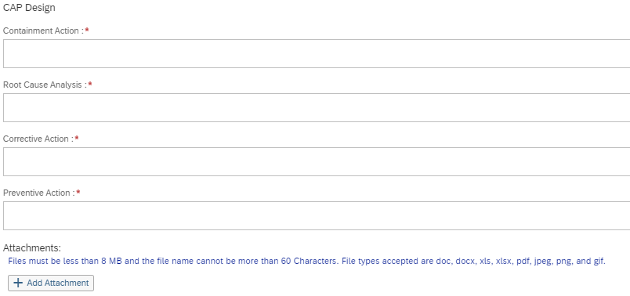
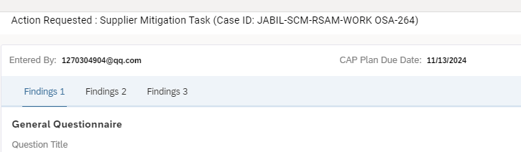
Submit CAP Design
Step 3：Read the Question Asked, Question Rating and Assessor’s Comments to understand why the findings were triggered.
Step 4: Complete the CAP Design, include Containment Action, Root Cause Analysis, Corrective Action and Preventive Action.
Notes:
1). Submit the CAP design to Jabil within 14 days.
2). （Optional）If the CAPs have already been implemented, upload the CAP implementation evidence at this step also.
Step 5: Click on the “Finding 1”/”Finding2” or click “Next” icon at the bottom and fill in all the findings.

Slide 9

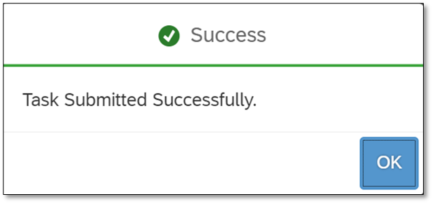
Submit CAP Design
Step 6：Click “Submit” icon at the bottom of the window to Submit the CAP Design to Jabil.
Function of icons:
Next: Switch to the next Findings Design
Save: Close with saving the progress. You can continue where you saved when you re-open the case. The case won’t be submitted to Jabil.
Submit: Submit the completed CAP design to Jabil.
When the case be submitted successfully, a “Success” message will show up. Then you can close the window by “X” on the top-right corner.
Next Step will be Jabil assessor review the CAP Design.

Slide 10
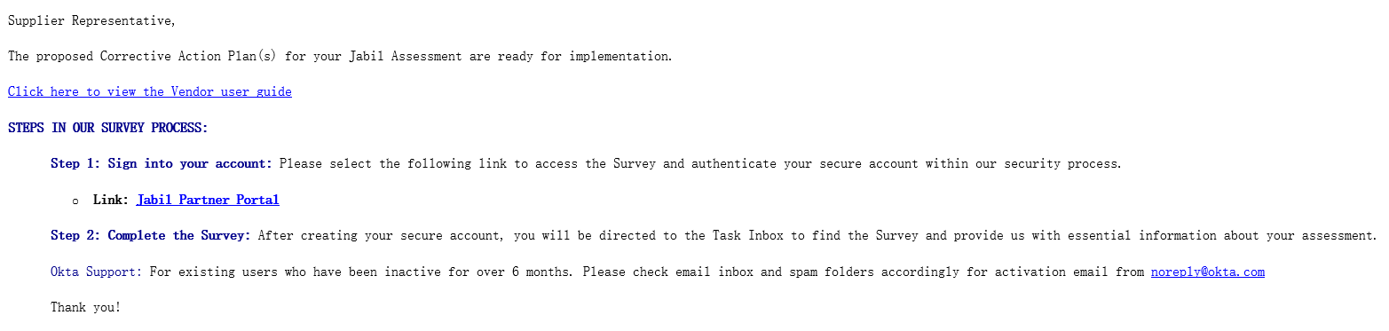
Submit CAP Implementation Evidence
Step 1: Open the OSA case.
After Jabil approved the CAP design, Vendor will receive a notification from Jabil. Vendor can open the OSA case by either of below ways:
Click the Link “Jabil Partner Portal”
Copy and paste the https link to browser.

Slide 11
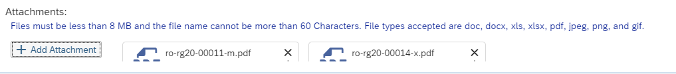
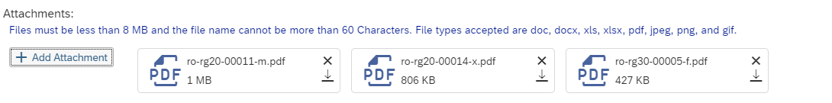
Submit CAP Implementation Evidence
Step 2：Upload documents as the CAP implementation evidence
If there are any documents has already been uploaded in CAP Design step, their document names will be displayed.
Click “Add Attachment”.
Choose File and upload the document from local folder.
Once uploaded successfully, the document name will be displayed.
Click “X” if the documents need to be deleted.
Notes:
1). Submit the implementation evidence to Jabil within 90 days since the CAP be initially assigned to you.

Slide 12

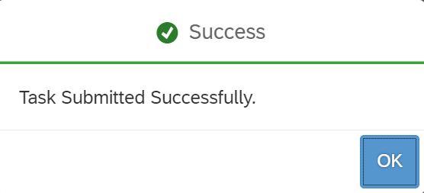
Submit CAP Implementation Evidence
Step 3：Click “Submit” icon at the bottom of the window to Submit the CAP Implementation evidence to Jabil.
Function of icons:
Next: Switch to the next Findings
Save: Close with saving the progress. You can continue where you saved when you re-open the case. The case won’t be submitted to Jabil.
Submit: Submit the completed CAP implementation to Jabil.
When the case be submitted successfully, a “Success” message will show up. Then you can close the window by “X” on the top-right corner.
Next Step will be Jabil assessor review the CAP Implementation evidence.

Slide 13
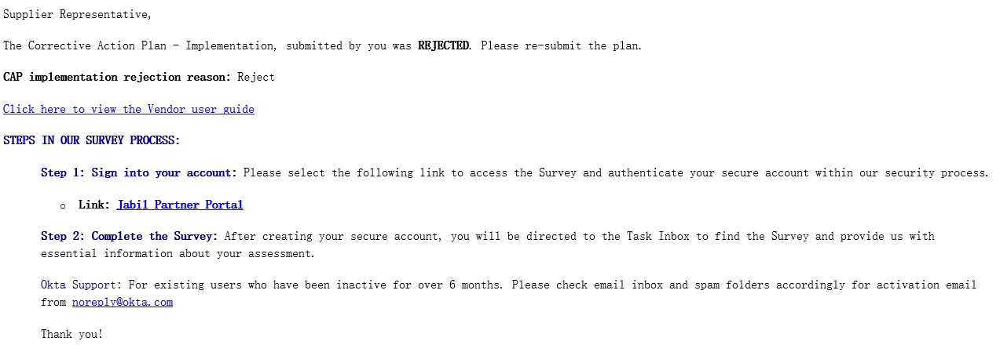
If CAP be Rejected by Jabil
When Jabil reject the CAP Design or CAP Implementation, vendor will receive a notification which contains the rejection reason.
There will be a new link in the notification for vendor to open the case.
If Jabil rejected the CAP Design, vendor need to modify the CAP and re-submit it.
If Jabil rejected the CAP Implementation, vendor needs to edit the documents to prove the CAP have been executed and the effectiveness meet expectation.

Slide 14
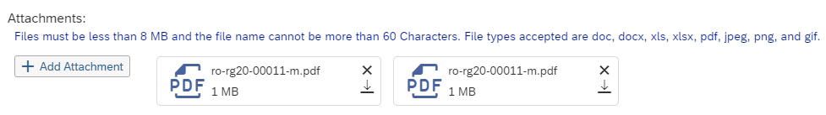
If CAP be Rejected by Jabil
Edit the documents of implementation evidence.
Delete documents:
You can find the previous uploaded files .Select the file and delete it. Once you submit, the selected documents will be deleted from the system.
Add documents:
Click “Add Attachment”, then select the documents you want to upload from the local folder. Repeat these steps if more than 1 documents you want to upload.

